Slide 1

The political behaviour of romanian migrants from france case study- romanian migrants from paris
Sorina Cârstea
Workshop May 2018 «Governance, Law, PLuralism and Trans-nationalisation in Europe : European Govenrnance and Legitimacy»
4th of May 2018

Slide 2
Presentation plan
Introduction ( choice of the subject, context, key concepts, a bit of literature)
Research questions
Methodology
Work in progress….☺

Slide 3
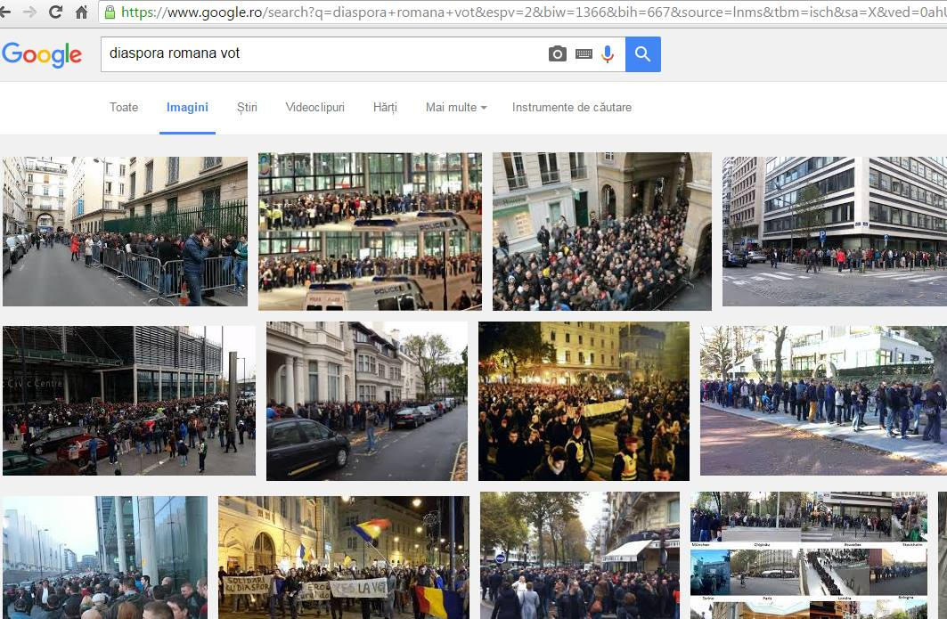
Choice & relevance of topic

Slide 4
Context
In the last sixteen years, the general trend in Romania was that of a decline in the electoral participation of citizens ...
…on the other hand, the electoral participation of Romanian diaspora hasn’t ceased to increase
Moreover, at the past two presidential elections, its vote was decisive
Year | Voter turnout at post-communist presidential elections in Romania
1990 | 86,19%
1992 | 76,03% (first round)
1992 | 73%( second round)
1996 | 76%(first round)
1996 | 75,09%( second round)
2000 | 65,03%(first round)
2000 | 57,05%(second round)
2004 | 58,93%(first round)
2004 | 55,02%( second round)
2009 | 53,52%( first tour)
2009 | 56,99%( second tour)
2014 | 52,31%( first tour)
2014 | 62,04%( second tour)
Year | Turnout for overseas Romanians at post-communist presidential elections*
1992 | 43.882
2000 | 33,169 (first round)
2000 | 16,331 (second round)
2004 | 40,868 first round)
2004 | 40,149 (second round)
2009 | 94,305 (first tour)
2009 | 147,795(second tour)
2014 | 147.754 (first tour)
2014 | 362.692 ( second tour)

Slide 5

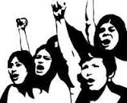

Key concepts
. Diaspora
according to its etymology, in the ancient Greek "speiro" means "to sow" and the preposition "dia" means "on", in other words "dissemination" or "dispersion" of a people..
Gérard-François Dumont defines the diaspora as "a group of individuals living on a territory and having in common the certainty or the feeling of being originating, themselves or their family, from another territory with which they maintain regular relations”
. Political participation
One of the most well-known definitions belongs to Sidney Verba and Norman.H.Nie: “a behavior designed to influence the choices of politicians / or government policies"»
unconventional forms of socio political participation, such as being part of an NGO, participate at demonstrations, strikes, boycotting & and conventional forms such as voting
. Electoral behaviour
→ the way people tend to vote (their political preferences) and the determinants of voting behaviour

Slide 6
Literature Review
Two types of approaches in researches that focus on the political behaviour and the political participation of migrants:
- researches that focus on the political participation of migrants in their host countries
-researches that focus on the political participation of migrants in their countries of origin
Two types of perspective on migration
- researches that treat migration from a transnational perspective( host country NOT view as being apart from country of origin)
Researches that treat migration from a national perspective( being part of a national state is CONTRADICTORY with the ideea of maintening transnational connections)

Slide 7
Research questions
Main research questions:
→ What are the political preferences of the Romanian diaspora from France?
→What are the possible reasons that may explain the increased political participation of the Romanian diaspora?
Other aspects I am interested in:
→ The importance given by the Romanian diaspora to the various administrative constraints
→The confidence of the members of the Romanian diaspora in themselves and in their ability to influence Romanian politics and contribute to the consolidation of democracy in Romania

Slide 8
Methodology
Semi-structured Interviews
Focus groups
Topics I want to explore during the interview →The migratory experience of the respondents, their political preferences, their opinions about the administrative constraints and the socio-political activities they choose to get involved in

Slide 9
